Slide 1
What Will You Choose?
Psalm 1

Slide 2
You Choose

Slide 3
You Choose

Slide 4
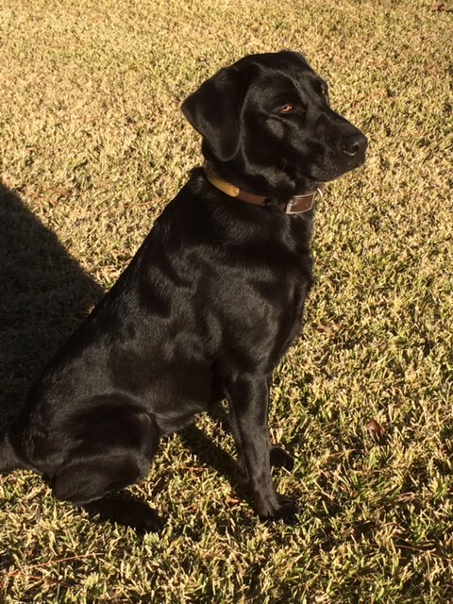
You Choose

Slide 5
You Choose

Slide 6
Psalm 1
1 Blessed is the man
who walks not in the counsel of the wicked,
nor stands in the way of sinners,
nor sits in the seat of scoffers;
2 but his delight is in the law of the LORD,
and on his law he meditates day and night.

Slide 7
Psalm 1
3 He is like a tree
planted by streams of water
that yields its fruit in its season,
and its leaf does not wither.
In all that he does, he prospers.
4 The wicked are not so,
but are like chaff that the wind drives away.

Slide 8
Psalm 1
5 Therefore the wicked will not stand in the judgment,
nor sinners in the congregation of the righteous;
6 for the LORD knows the way of the righteous,
but the way of the wicked will perish.

Slide 9
Outline
Two Paths (1-2)
Two Pictures (3-4)
Two Destinations (5-6)

Slide 10
Two Paths
We are all headed down one of two paths. (1-2)
  First Path: Disregard for God’s Word (1)
  Second Path: Devotion to God’s Word (2)

Slide 11
Two Paths
Which path are you on?

Slide 12
Two Pictures
The paths are illustrated by two very different pictures. (3-4)
  First Picture: Tree Bearing Fruit (3)
  Second Picture: Chaff Blown by the Wind (4)

Slide 13
Two Pictures
Which picture best illustrates your life?

Slide 14
Two Destinations
The paths lead to very different destinations. (5-6)
  First Destination: Fellowship & Life
  Second Destination: Judgment & Death

Slide 15
Two Destinations
Do you know where you are going?

Slide 16
Matthew 7:13-14
13 Enter by the narrow gate. For the gate is wide and the way is easy that leads to destruction, and those who enter by it are many. 14 For the gate is narrow and the way is hard that leads to life, and those who find it are few.

