Slide 2
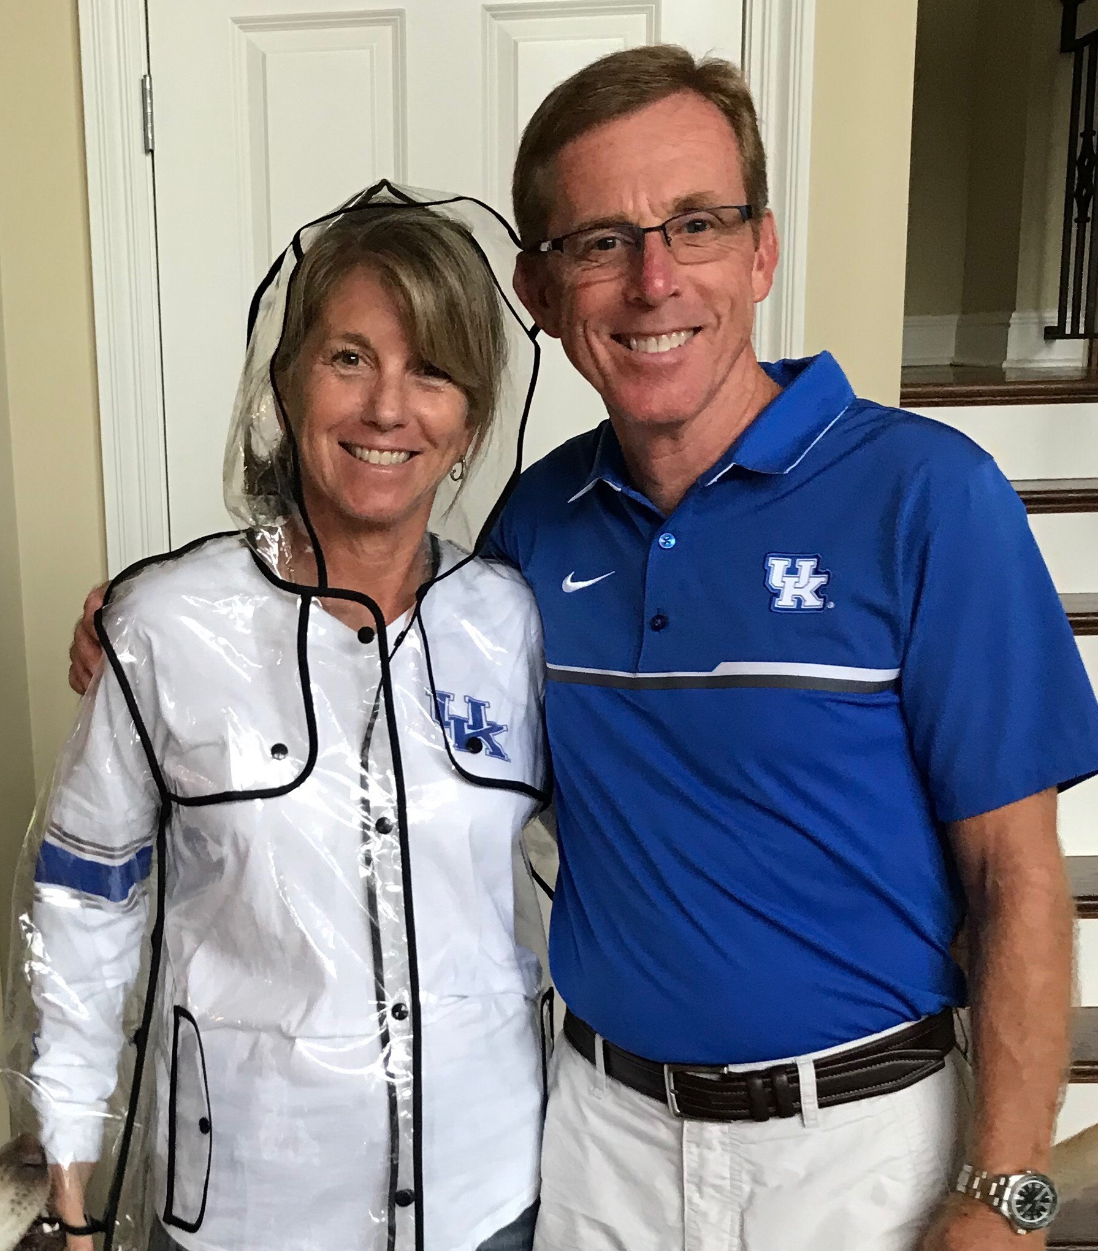

Slide 3


Slide 4


Slide 5
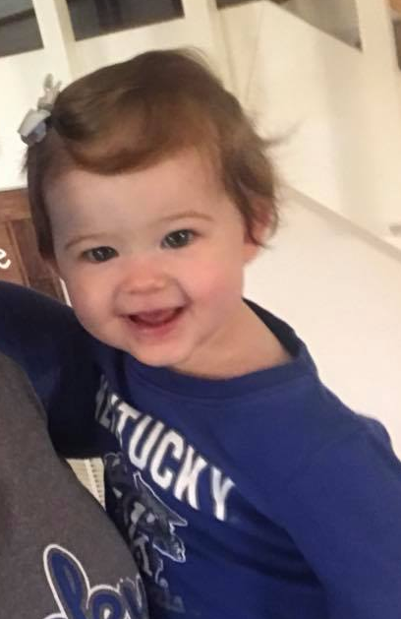
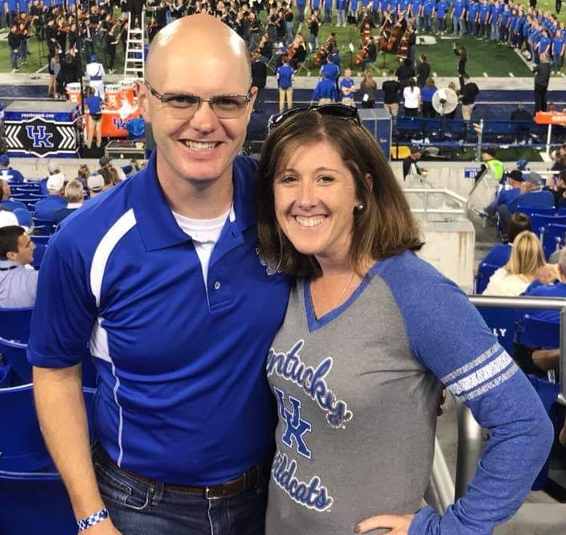
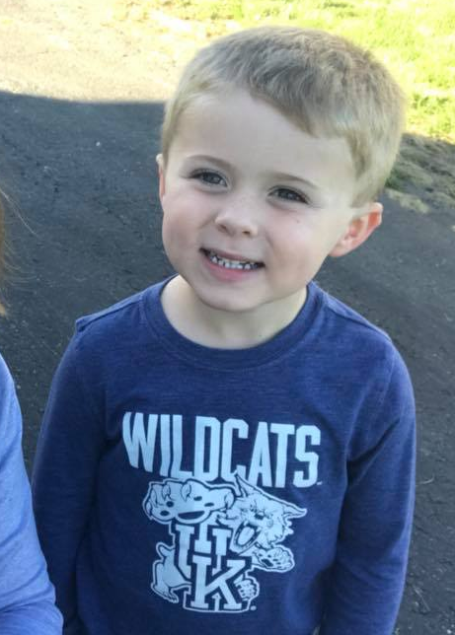

Slide 6
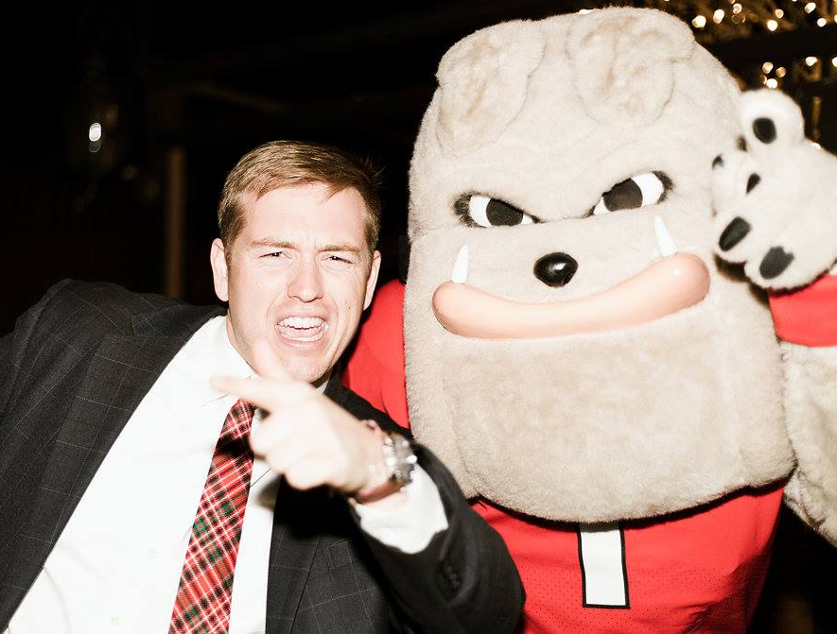

Slide 7


Slide 8
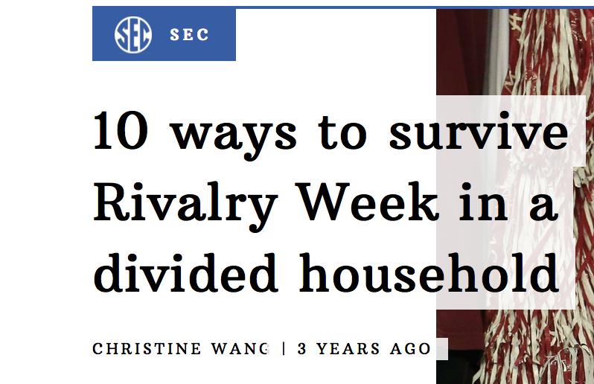

Slide 9
QUESTIONS
OPINIONS
CONVICTIONS
ESSENTIALS

Slide 10
WHAT IS AT STAKE?
UNITY OF THE BODY
SIN AGAINST GOD
DESTRUCTION OF THE BELIEVER

Slide 11
WHEN IT COMES TO MATTERS OF OPINION…
ALL THINGS ARE CLEAN BUT…
JUDGING OTHERS IS NOT
IGNORING YOUR CONSCIENCE IS NOT
CAUSING OTHERS TO COMPROMISE IS NOT

Slide 12
ALL THINGS ARE CLEAN BUT…
JUDGING OTHERS IS NOT
(vv. 3-4, 10-12)

Slide 13
JUDGMENT: admonition apart from clear manifestations of brotherly love; condemnation
1 THESSALONIANS 5:14 → 4:9
COLOSSIANS 3:16 → 3:14
1 CORINTHIANS 4:13 → 13:4-7
HEBREWS 10:24-25 → 13:1

Slide 14
ALL THINGS ARE CLEAN BUT…
IGNORING YOUR CONSCIENCE IS NOT
(vv. 5-9, 14, 22b-23)

Slide 15
MOTIVES FOR HOW WE HANDLE MATTERS OF OPINION:
SELFISH OR NAÏVE PASSIVITY
CLEAR DEFIANCE
RIGHTEOUS INTENTIONALITY

Slide 16
ALL THINGS ARE CLEAN BUT…
CAUSING OTHERS TO COMPROMISE IS NOT
(vv. 13, 15-16, 20-22a)

Slide 17
BROTHER’S KEEPER:
ONE DRINK (FREE BUT TEMPTED) → DRUNKENESS (CLEAR SIN)
ROMANS 14 STUMBLING BLOCK:
ONE DRINK (GUILTY CONSCIENCE) → PORNOGRAPHY BINGE (CLEAR SIN)

Slide 18
WHEN IT COMES TO MATTERS OF OPINION…
ALL THINGS ARE CLEAN BUT…
JUDGING OTHERS IS NOT
IGNORING YOUR CONSCIENCE IS NOT
CAUSING OTHERS TO COMPROMISE IS NOT

Slide 19
Announcements
Please be sure to sign in and print a name tag. It has your small group room in the corner.
If you do not have a small group, stay in here and come to the front where Hil Bowman and Rob Heath will lead the Open Group.
If your group meets in the West Tower, please use the skybridge.

