Slide 2
Romans 7:7-25
How do we walk in faithful obedience to God along the Christian journey?

Slide 3
The believer’s ongoing struggle with sin.
Notes:
The ground is level at the foot of the cross. All you have and all you bring is NOTHING.

Slide 4
Preview
Paul’s soteriology & the purpose of the Law.
What does the believer's regular struggle with sin look like?
How do we emerge victorious over sin?
Notes:
The ground is level at the foot of the cross. All you have and all you bring is NOTHING.

Slide 5
Paul’s soteriology & the purpose of the Law.
Positional Truth: The sinful nature of believers has been crucified with Christ, we are no longer slaves to sin.
Notes:
The ground is level at the foot of the cross. All you have and all you bring is NOTHING.

Slide 6
Paul’s soteriology & the purpose of the Law.
Romans 6:6-7
For we know that our old self was crucified with him so that the body ruled by sin might be done away with, that we should no longer be slaves to sin because anyone who has died has been set free from sin.
Notes:
The ground is level at the foot of the cross. All you have and all you bring is NOTHING.

Slide 7
Paul’s soteriology & the purpose of the Law.
Practical Expression: Believers are in the midst of a war for righteousness.
Notes:
The ground is level at the foot of the cross. All you have and all you bring is NOTHING.

Slide 8
Paul’s soteriology & the purpose of the Law.
Galatians 5:17
For the flesh desires what is contrary to the Spirit, and the Spirit what is contrary to the flesh. They are in conflict with each other, so that you are not to do whatever you want.
Notes:
The ground is level at the foot of the cross. All you have and all you bring is NOTHING.

Slide 9
Paul’s soteriology & the purpose of the Law.
Positionally, a believer is fully justified, sanctified & glorified by their trust in the work of Christ while at the same time from a practical standpoint, we are fully justified, continually being sanctified and awaiting glorification.
Notes:
The ground is level at the foot of the cross. All you have and all you bring is NOTHING.

Slide 10
Paul’s soteriology & the purpose of the Law.
While our old selves have been crucified with Christ on the cross, as long as we live in a fallen, broken world, with fallen, broken human bodies, the magnetic pull and desire of sin will continue to wage war against our regenerated minds and heart.
Notes:
The ground is level at the foot of the cross. All you have and all you bring is NOTHING.

Slide 11
Paul’s soteriology & the purpose of the Law.
Romans 7:7-12
What shall we say, then? Is the law sinful? Certainly not! Nevertheless, I would not have known what sin was had it not been for the law. For I would not have known what coveting really was if the law had not said, “You shall not covet.”
Notes:
The ground is level at the foot of the cross. All you have and all you bring is NOTHING.

Slide 12
Paul’s soteriology & the purpose of the Law.
⁸ But sin, seizing the opportunity afforded by the commandment, produced in me every kind of coveting. For apart from the law, sin was dead. ⁹ Once I was alive apart from the law; but when the commandment came, sin sprang to life and I died.
Notes:
The ground is level at the foot of the cross. All you have and all you bring is NOTHING.

Slide 13
Paul’s soteriology & the purpose of the Law.
¹⁰ I found that the very commandment that was intended to bring life actually brought death. ¹¹ For sin, seizing the opportunity afforded by the commandment, deceived me, and through the commandment put me to death. ¹² So then, the law is holy, and the commandment is holy, righteous and good.
Notes:
The ground is level at the foot of the cross. All you have and all you bring is NOTHING.

Slide 14
Paul’s soteriology & the purpose of the Law.
God’s Law was meant to show us that we are wired to disobey
Notes:
The ground is level at the foot of the cross. All you have and all you bring is NOTHING.

Slide 15
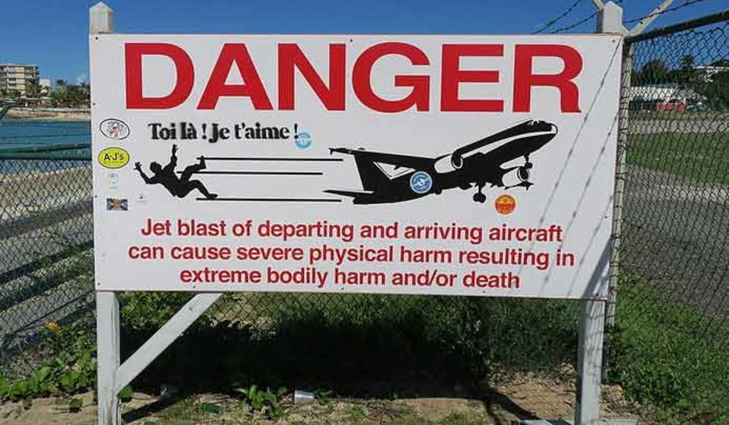
Notes:
The ground is level at the foot of the cross. All you have and all you bring is NOTHING.

Slide 16
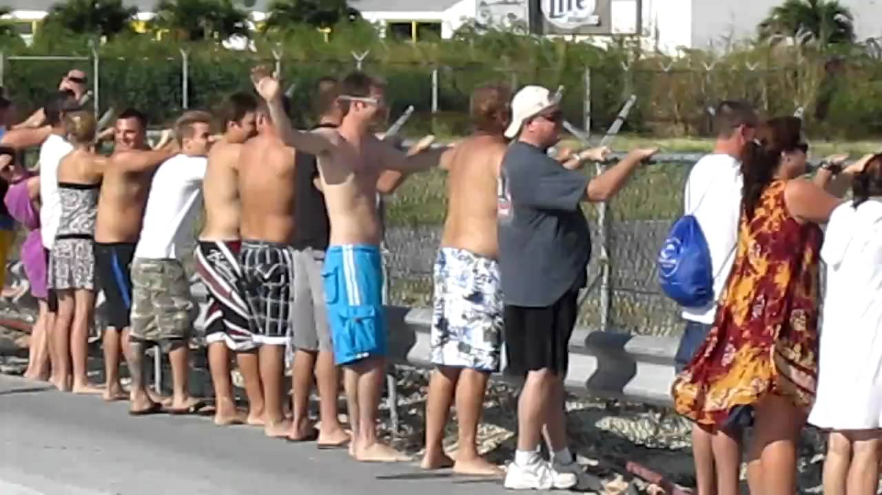
Notes:
The ground is level at the foot of the cross. All you have and all you bring is NOTHING.

Slide 17
Paul’s soteriology & the purpose of the Law.
God’s Law was meant to show us that we are wired to disobey
God’s Law was meant to point us to Christ
Notes:
The ground is level at the foot of the cross. All you have and all you bring is NOTHING.

Slide 18
Paul’s soteriology & the purpose of the Law.
The Law doesn’t cause us to sin, it just reveals what is already true. So seeking to grow in sanctification by obeying rules & regulations is an empty pursuit and robs the Law of its intended purpose.
Notes:
The ground is level at the foot of the cross. All you have and all you bring is NOTHING.

Slide 19
What does the believer's regular struggle with sin look like?
Romans 7:21-23
So I find this law at work: Although I want to do good, evil is right there with me. ²² For in my inner being I delight in God’s law; ²³ but I see another law at work in me, waging war against the law of my mind and making me a prisoner of the law of sin at work within me.
Notes:
The ground is level at the foot of the cross. All you have and all you bring is NOTHING.

Slide 20
How do we emerge victorious over sin?
Romans 7:24
What a wretched man I am! Who will rescue me from this body that is subject to death?
Notes:
The ground is level at the foot of the cross. All you have and all you bring is NOTHING.

Slide 21
How do we emerge victorious over sin?
Romans 7:24
What a wretched man I am! Who will rescue me from this body that is subject to death?
Answer:
Romans 7:25
²⁵ Thanks be to God, who delivers me through Jesus Christ our Lord!
Notes:
The ground is level at the foot of the cross. All you have and all you bring is NOTHING.

Slide 22
How do we emerge victorious over sin?
Sin is powerful. Don’t underestimate it.
We are not strong enough to overcome it. Don’t overestimate yourself.
Satan is hard at work, and deep down, we want to sin.
Sin is only overcome by surrender to the tremendous power of Christ.
Notes:
The ground is level at the foot of the cross. All you have and all you bring is NOTHING.

Slide 23
Summary & Conclusion
Until the day when the battle with sin is finally over, we have the work of surrendering our passions and desires to Christ and allowing His Word, Spirit & people to transform us moment by moment.
Notes:
The ground is level at the foot of the cross. All you have and all you bring is NOTHING.

Slide 24
Summary & Conclusion
It is normal to wrestle, struggle and battle with sin. It is natural to fail. But it is also normal to experience victory because “He who began a good work in you will carry it on to completion until the day of Christ Jesus.”
Notes:
The ground is level at the foot of the cross. All you have and all you bring is NOTHING.

