Slide 2
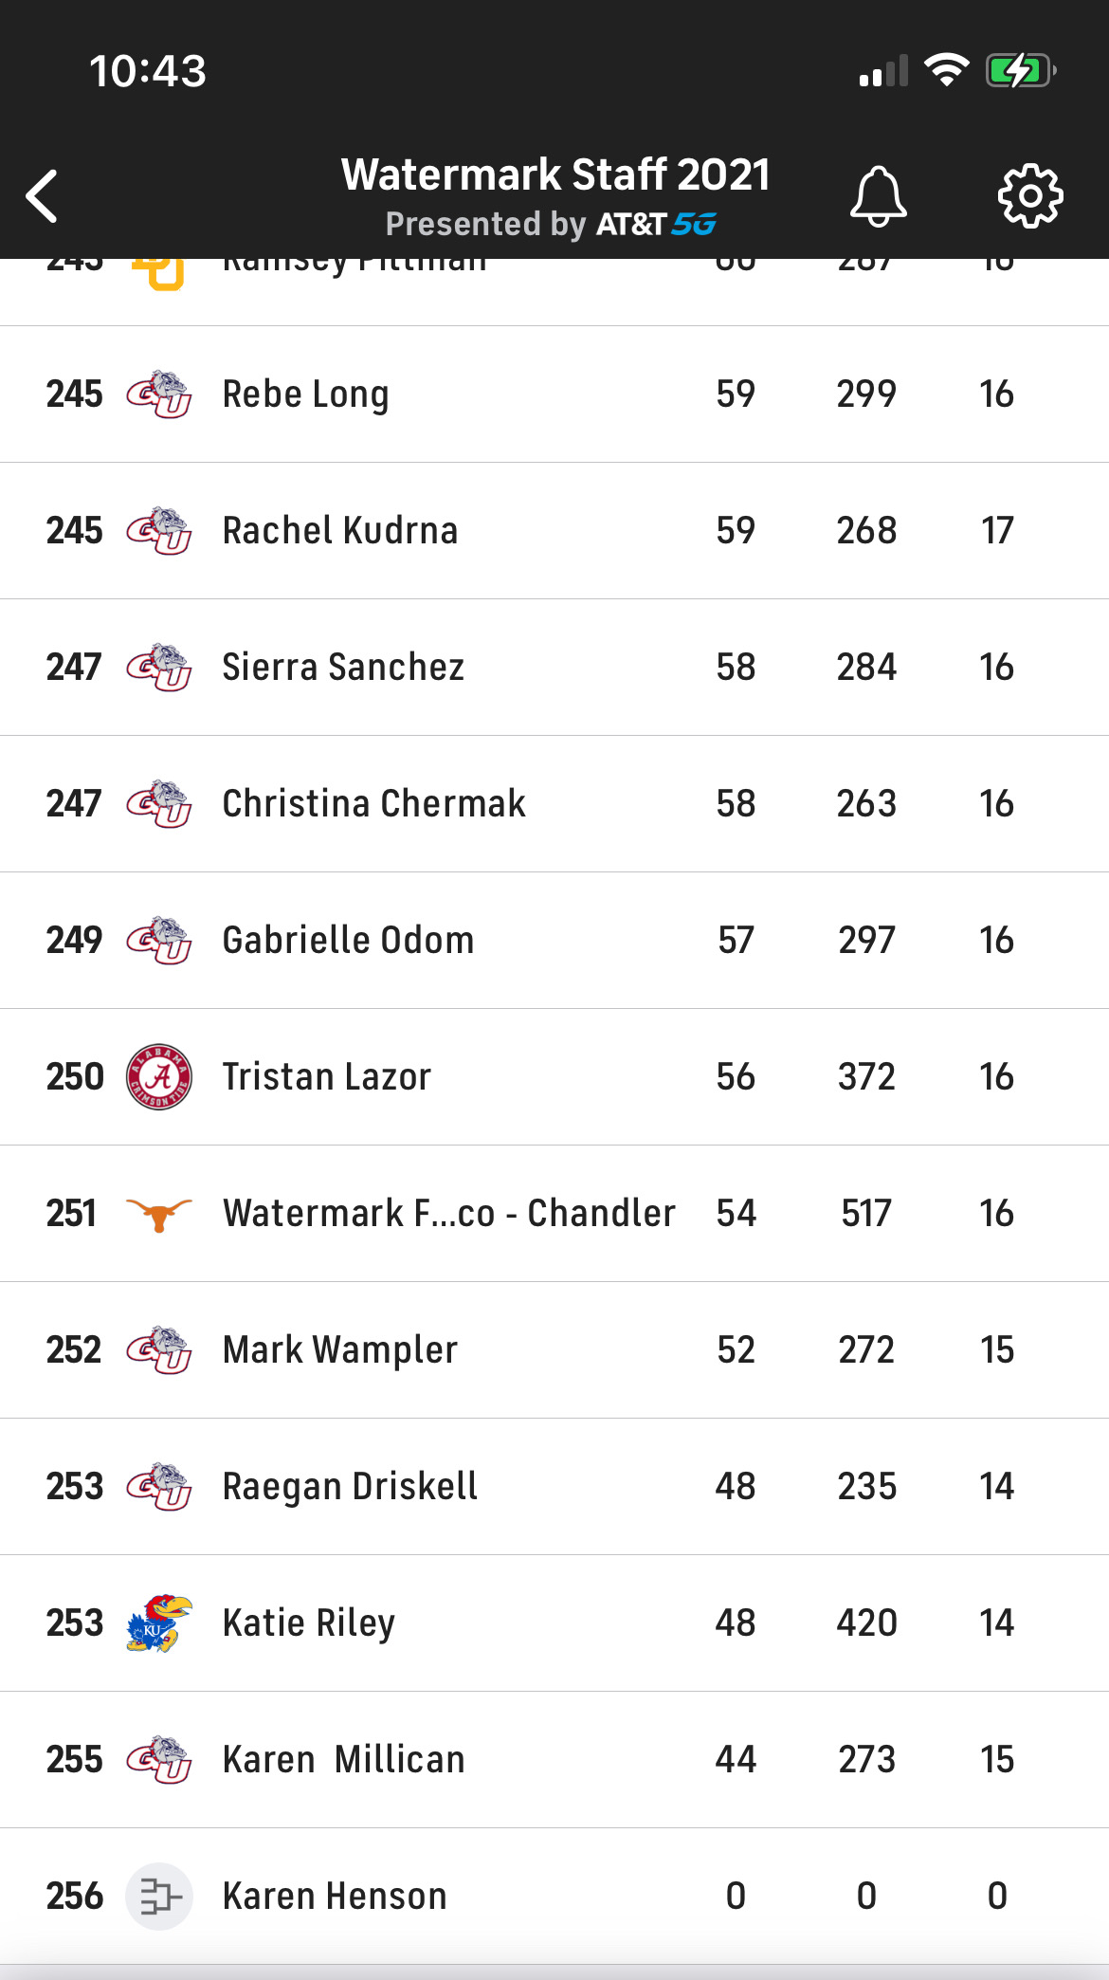

Slide 3
God’s Faithfulness Remains
Ruth 4:1-12: Ruth’s Redemption
Ruth 4:13-17: Ruth’s Marriage
Ruth 4:18-22: Ruth’s Lineage

Slide 4
Ruth 4:1-12: Ruth’s Redemption
Love Requires Sacrifice

Slide 5
Ruth 4:13-17: Ruth’s Marriage
Redemption Leads to Change

Slide 6
“In him we have redemption through his blood, the forgiveness of sins, in accordance with the riches of God’s grace that he lavished on us.” Ephesians 1:7-8
“And you, who once were alienated and hostile in mind, doing evil deed, he has now reconciled in his body of flesh by his death, in order to present you holy and blameless and above reproach before him…” Colossians 1:20-21
“Therefore, if anyone is in Christ, he is a new creation. The old has passed away; behold, the new has come.” 2 Corinthians 5:17

Slide 7
Ruth 4:18-22: Ruth’s Lineage
God’s Story is so much bigger than our own

Slide 8
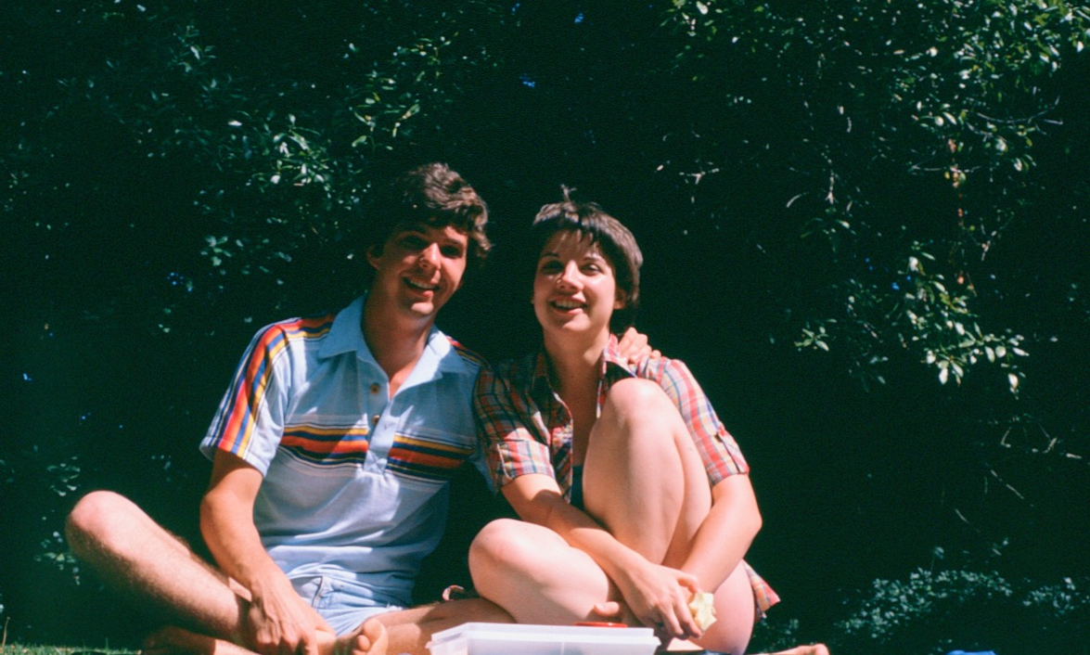

Slide 9
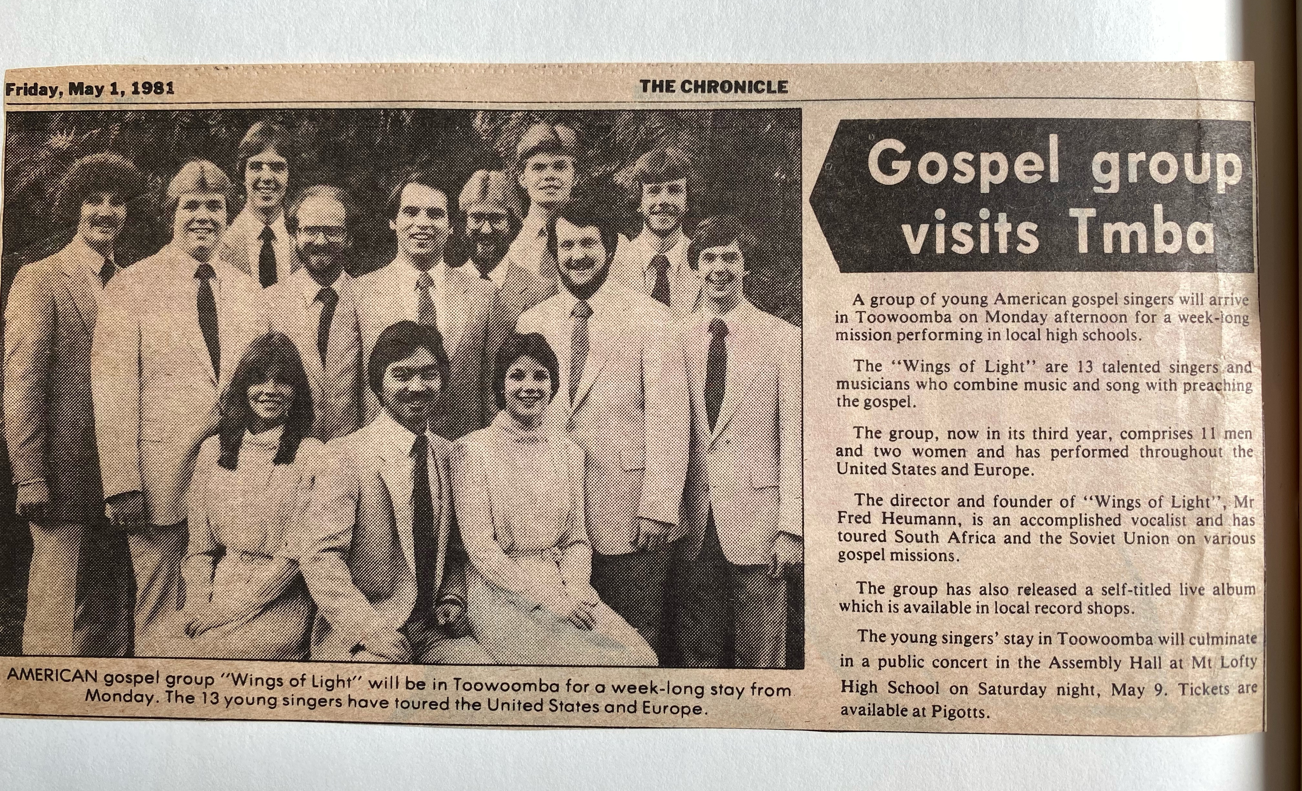

Slide 10
God’s Faithfulness Remains

