Slide 2
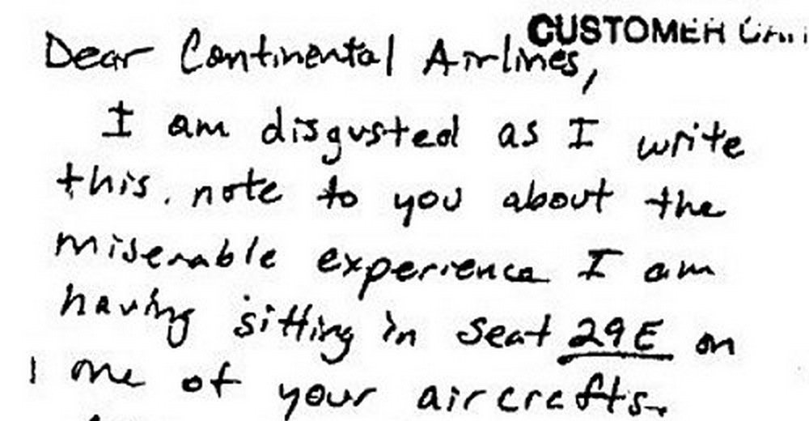

Slide 3
“And we know that for those who love God, all things work together for good…”
Romans 8:28

Slide 4
“Suffering is having what you don’t want or wanting what you don’t have.”
Elisabeth Elliot, A Path Through Suffering

Slide 5
¹⁶ The Spirit himself bears witness with our spirit that we are children of God, ¹⁷ and if children, then heirs—heirs of God and fellow heirs with Christ, provided we suffer with him in order that we may also be glorified with him. ¹⁸ For I consider that the sufferings of this present time are not worth comparing with the glory that is to be revealed to us.
Romans 8:16-18

Slide 6
PERSPECTIVE
Christian suffering is normal.

Slide 7
²⁶ Likewise the Spirit helps us in our weakness. For we do not know what to pray for as we ought, but the Spirit himself intercedes for us with groanings too deep for words. ²⁷ And he who searches hearts knows what is the mind of the Spirit, because the Spirit intercedes for the saints according to the will of God.
Romans 8:26-27

Slide 8
(2) PRAYER
It’s okay when you don’t know what to pray.

Slide 9
Prayer 101
I feel…
I wish…
I’m struggling…

Slide 10
²⁸ And we know that for those who love God all things work together for good, for those who are called according to his purpose. ²⁹ For those whom he foreknew he also predestined to be conformed to the image of his Son, in order that he might be the firstborn among many brothers.
Romans 8:28-29

Slide 11
(3) PURPOSE
Your pain is not pointless.

Slide 12
²⁸ And we know that for those who love God all things work together for good, for those who are called according to his purpose. ²⁹ For those whom he foreknew he also predestined to be conformed to the image of his Son, in order that he might be the firstborn among many brothers.
Romans 8:28-29

Slide 13
²⁸ And we know that for those who love God all things work together for good, for those who are called according to his purpose. ²⁹ For those whom he foreknew he also predestined to be conformed to the image of his Son, in order that he might be the firstborn among many brothers.
Romans 8:28-29

Slide 14
²⁸ And we know that for those who love God all things work together for good, for those who are called according to his purpose. ²⁹ For those whom he foreknew he also predestined to be conformed to the image of his Son, in order that he might be the firstborn among many brothers.
Romans 8:28-29

Slide 15
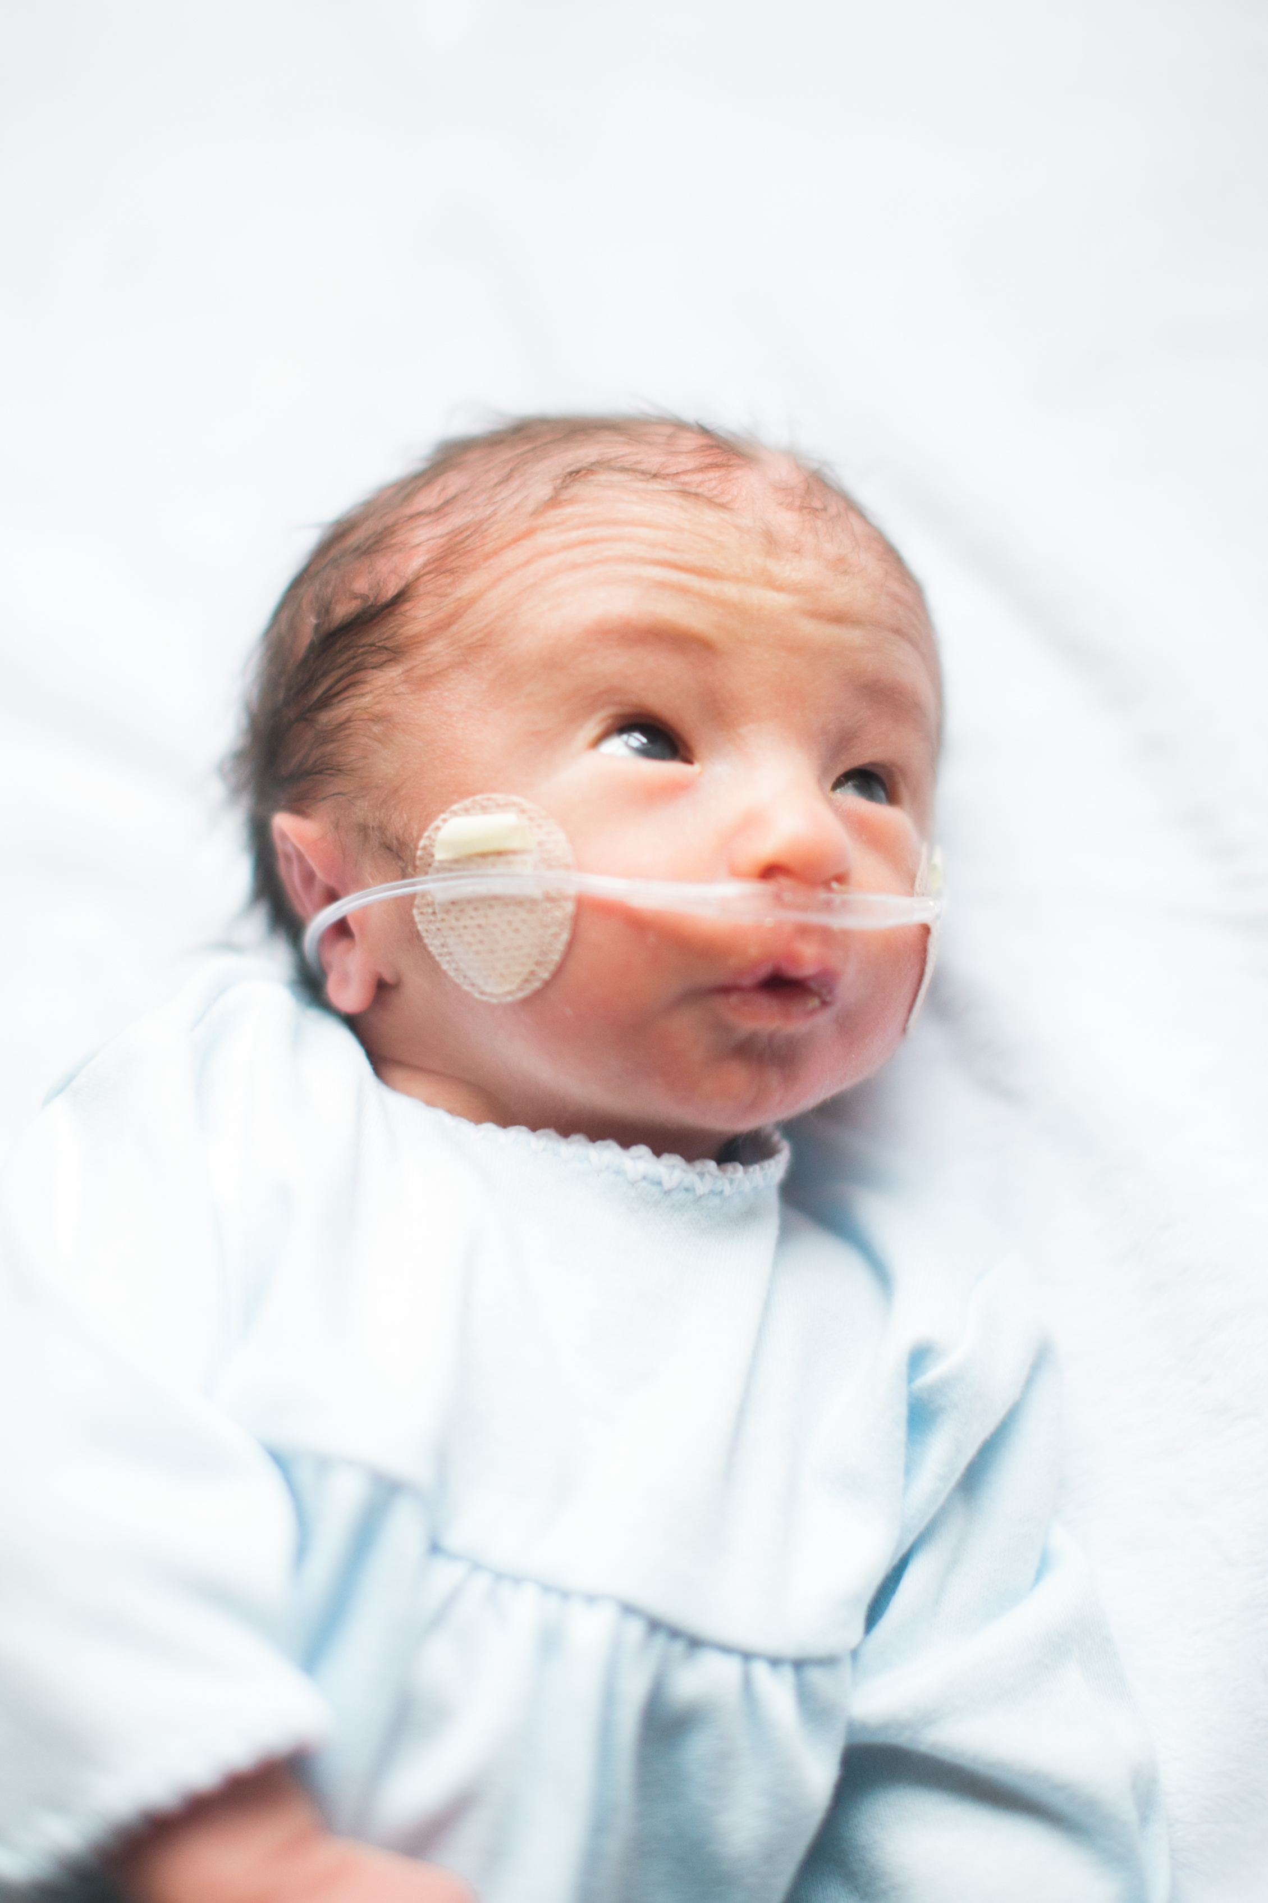

Slide 16
Closing Reflections
Joy & Sorrow
External vs. Eternal
Abel still speaks (AbelSpeaks.org)
Understanding vs. Knowing

Slide 17
Announcements
Please be sure to sign in and print a name tag. It has your small group room in the corner.
If you do not have a small group, stay in here and come to the front where Hil Bowman and Rob Heath will lead the Open Group.
If your group meets in the West Tower, please use the skybridge.

